Slide 1
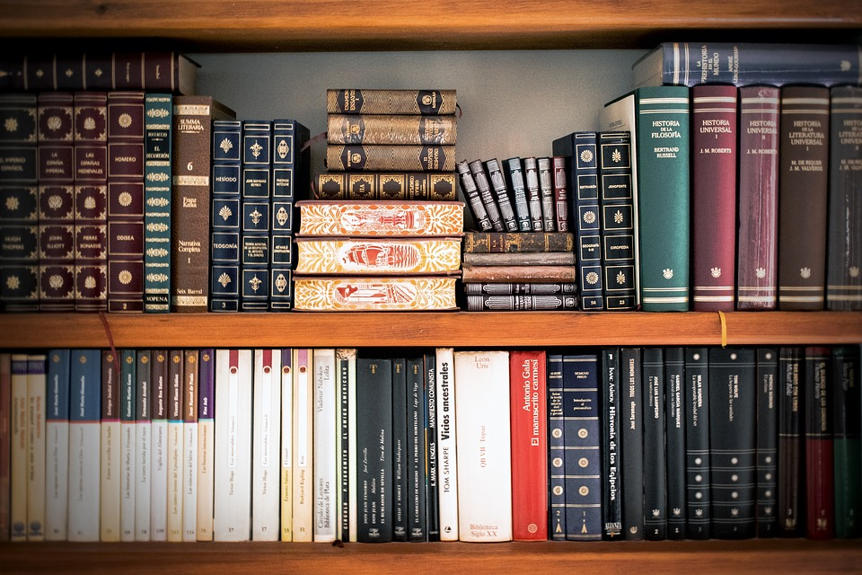
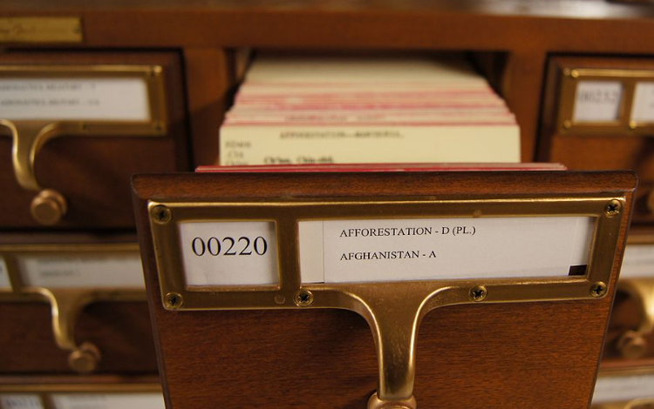

Data Carving
Read a book without an index card

Slide 2
Overview
How does a file system retrieve a file’s content? (review)
File content structure overview (review)
Exam file content using xxd
What is data carving?
Scenario 1: carving embedded files
Extracting images from a corrupted Word document using bless
Scenario 2: carving deleted files
Carving a USB image using scalpel

Slide 3
How does a file system retrieve a file’s content?

Slide 4
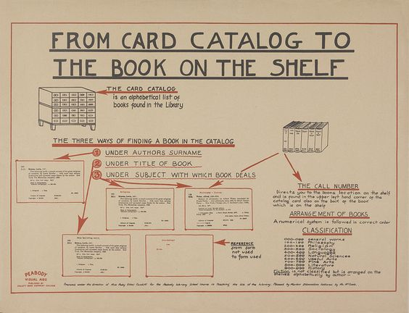

Slide 5
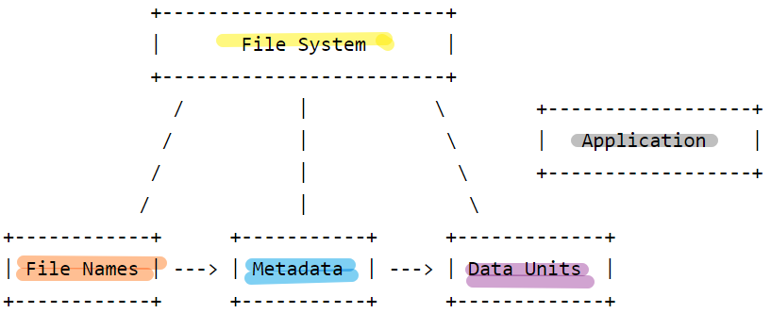
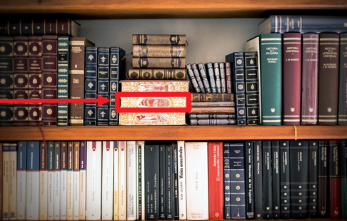
index card (file system/file metadata) may be damaged

Slide 6
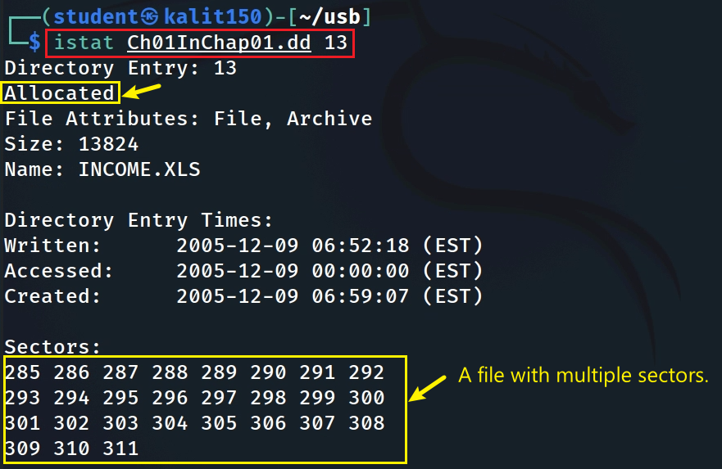
Scenario 1: Directly access data units (sectors) of a file in a dd image (FAT)
https://www.dropbox.com/s/nw23q14vzsykyup/Ch01InChap01.dd
icat disk_image inodeID
blkcat disk_image sectorID [n]
27 sector & 512 bytes
Notes:
https://www.dropbox.com/s/nw23q14vzsykyup/Ch01InChap01.dd

Slide 7
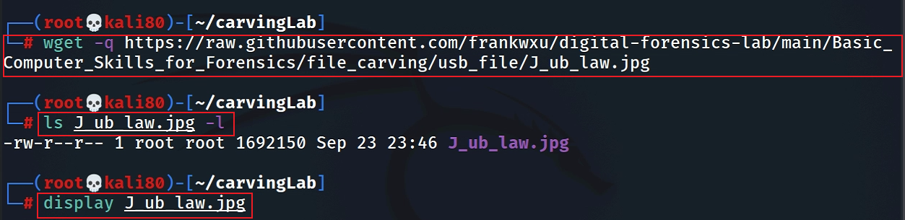
Scenario 2: Directly access data units (blocks) of a file in Linux (Ext4)
Download an image to Kali
sudo apt install imagemagick
if display doesn’t work
Notes:
wget -q https://raw.githubusercontent.com/frankwxu/digital-forensics-lab/main/Basic_Computer_Skills_for_Forensics/file_carving/usb_file/J_ub_law.jpg

Slide 8
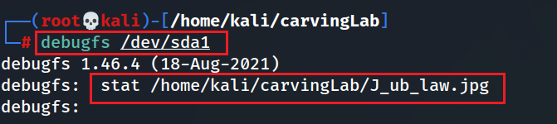
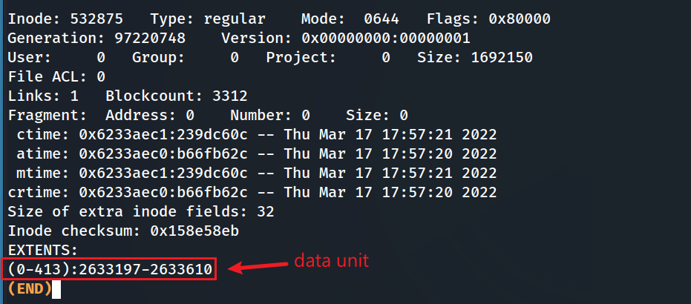
Show data units (blocks) of the image using debugfs
real size (1 block is 4k)
Notes:
sudo tune2fs -l /dev/sda1 | grep Block

Slide 9
File content structure overview

Slide 10
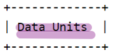


File Content overview
File signature
File content Metadata
referred to as a magic number,
a constant numerical/text value
used to identify a file format
content
reference to
istat: Displays the statistics and details about a given meta data structure in an easy-to-read format.
Tail signature
Content

Slide 11
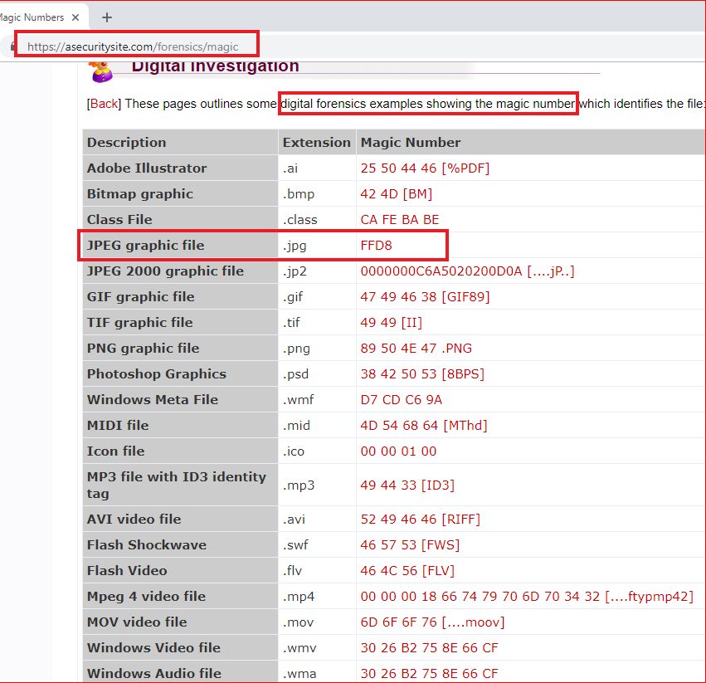
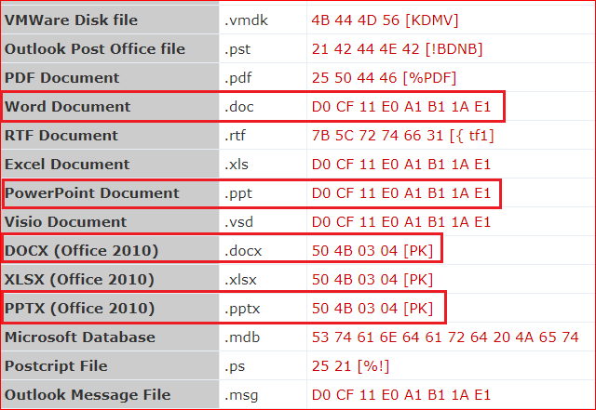

Slide 12
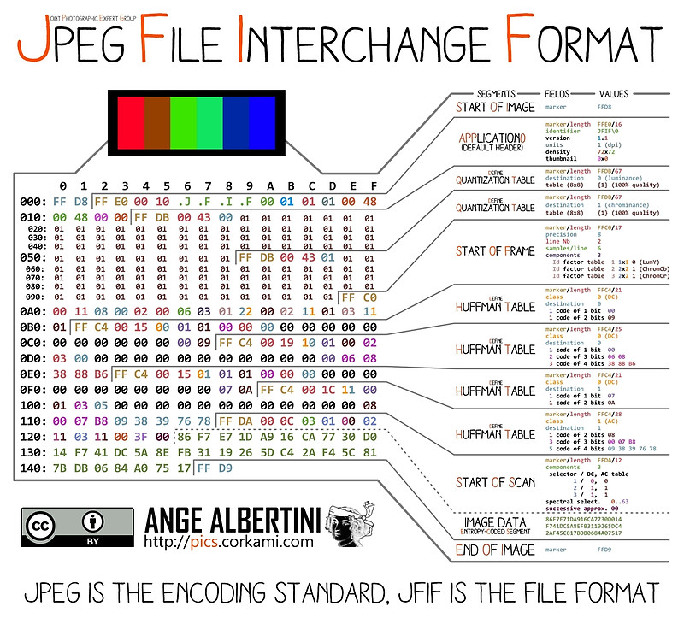
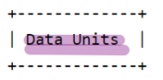
An example of image file content internal structure
points to
points to
Notes:
https://www.offshoreclippingpath.com/difference-between-jpg-and-jpeg/

Slide 13
[SOI] → [APP0] → [APP1/Exif] → [COM] → [DQT] → [SOF0] → [DHT] → [SOS] → [Image Data] → [EOI]
| | | | | | |
| | | | | | +-- Start of Scan (compressed data begins)
| | | | | +-- Define Huffman Table(s)
| | | | +-- Start of Frame (image dimensions, components)
| | | +-- Define Quantization Table(s)
| | +-- Comment (optional)
| +-- Exif metadata (optional)
+-- JFIF metadata (e.g., resolution, thumbnail)
5 .DQT (Define Quantization Table)
Marker: 0xFFDB
Purpose: Specifies quantization tables for image compression.
Size: Variable (e.g., 67 bytes per table).
6. SOF0 (Start of Frame)
Marker: 0xFFC0
Purpose: Defines image dimensions, color components, and sampling.
Size: Fixed 17 bytes for an 8-bit grayscale or YCbCr image.
7. DHT (Define Huffman Table)
Marker: 0xFFC4
Purpose: Specifies Huffman coding tables for entropy encoding.
Size: Variable (e.g., 50–400 bytes per table).
8. SOS (Start of Scan)
Marker: 0xFFDA
Purpose: Marks the start of compressed image data.
Size: Fixed 12 bytes (precedes actual pixel data).
9. Compressed Image Data
Structure: Entropy-encoded scan data (Huffman/arithmetic coded).
Ends with: 0xFFD9 (EOI marker).
10. EOI (End of Image)
Marker: 0xFFD9
Purpose: Marks the end of the JPEG file.
Size: Fixed 2 bytes.
SOI (Start of Image)
Marker: 0xFFD8
Purpose: Marks the beginning of the JPEG file.
Size: Fixed 2 bytes.
APP0 (JFIF Segment)
Marker: 0xFFE0
Purpose: Contains basic metadata (e.g., version, resolution, optional thumbnail).
Size: Variable (typically 16–20 bytes for basic JFIF data).
APP1 (Exif Segment)
Marker: 0xFFE1
Purpose: Stores Exif metadata (e.g., camera settings, GPS, timestamps).
Size: Variable (often 2–10 KB).
COM (Comment)
Marker: 0xFFFE
Purpose: Optional text comment.
Size: Variable (user-defined).

Slide 14
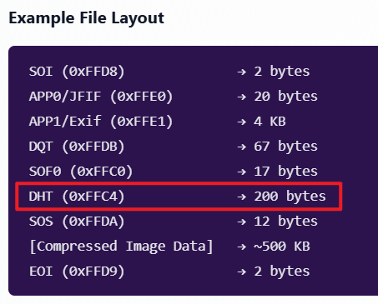
Compressed content- Huffman Coding
JPEG Image Compression
Described in Define Huffman Table (DHT)
Invented by David Huffman
a graduate student at MIT in 1952
as part of his coursework.
Huffman coding can be used to compress all sorts of data.
It is an entropy-based algorithm that relies on analyzing the frequency of symbols in an array.

Slide 15

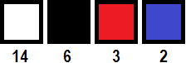
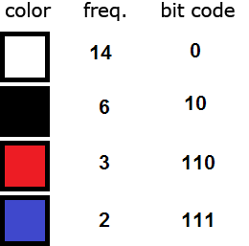
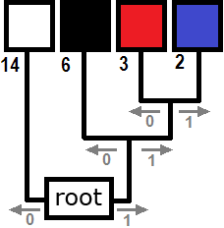
Each pixel requires 14 bits = 2³ (row)+2³ (col)+2⁸ (color)
(000)(100)(11111111)
Total: [6 (position) + 8 (color) ]*25=250
Before compression
sort the colors in order of decreasing frequency.
traverse from root to each color
colors farthest from the root are the least frequent.
Total bits required after compression:
25 x 6 (position)+
14 x 1 + 6 x 2 + 3 x 3 + 2 x 3 (color)
= 150+41 =191
Compression process
After Compression
Notes:
https://www.print-driver.com/stories/huffman-coding-jpeg

Slide 16
Examining File Content
using xxd

Slide 17

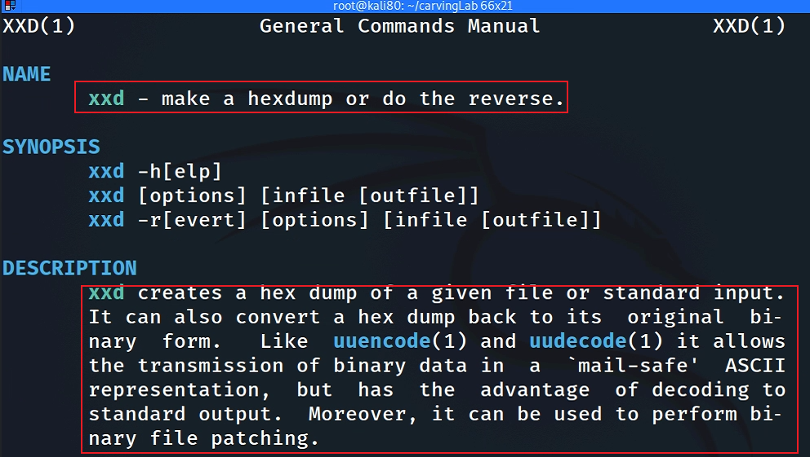
What is xxd? cli version of + binary file
disk
xxd
hex dump

Slide 18

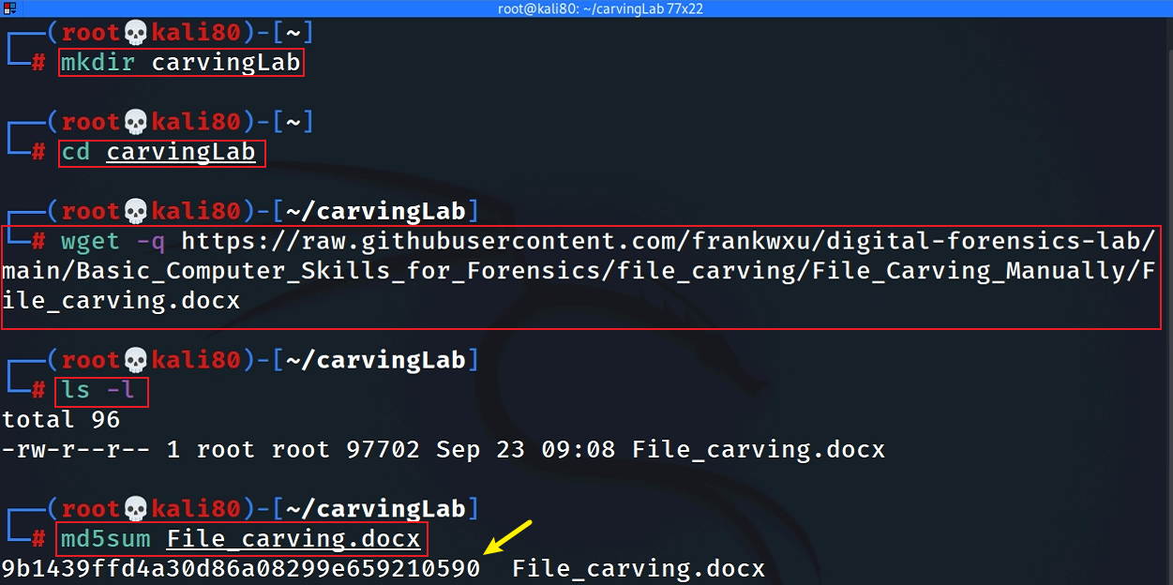
Get a jpg to show signature
sudo apt install imagemagick
if display doesn’t work
Notes:
wget -q https://raw.githubusercontent.com/frankwxu/digital-forensics-lab/main/Basic_Computer_Skills_for_Forensics/file_carving/usb_file/J_ub_law.jpg

Slide 19
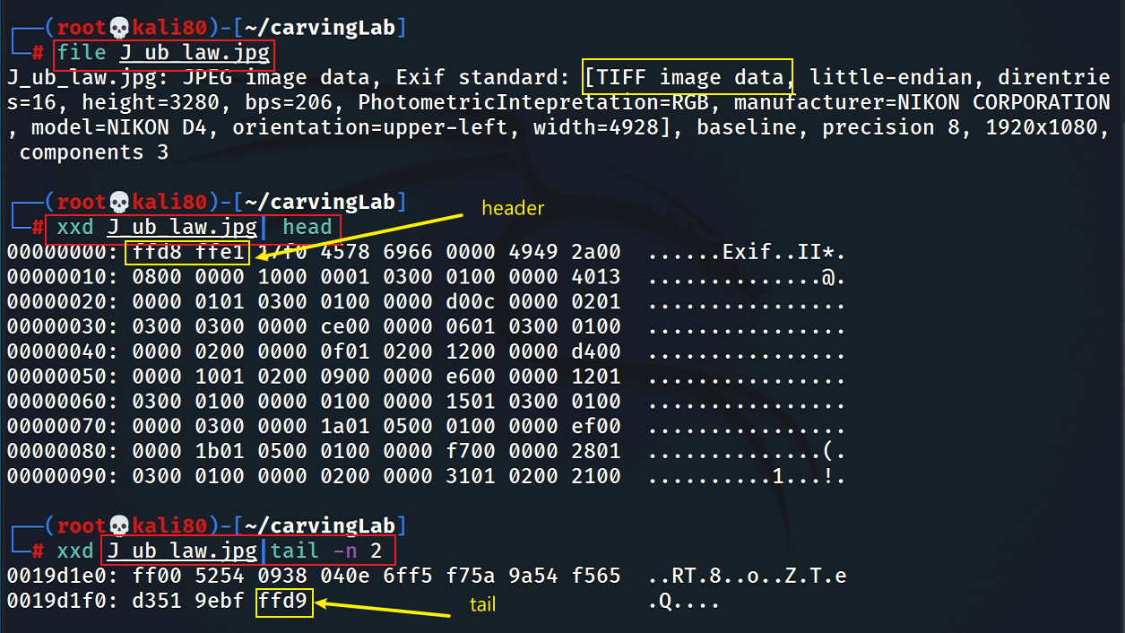
Show JPG header and tail signatures
The picture is taken by NIKON D4

Slide 20
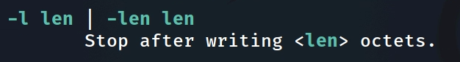
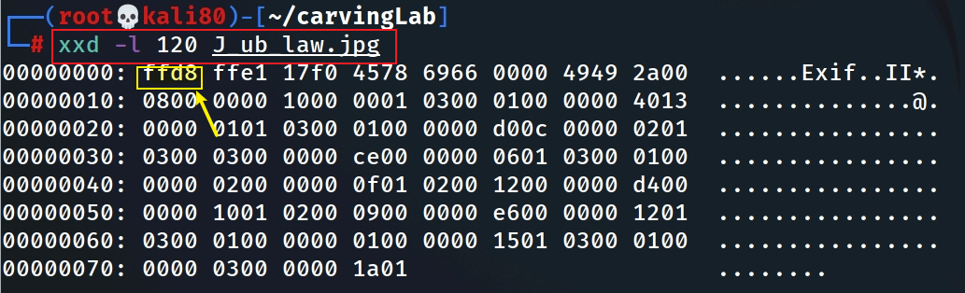
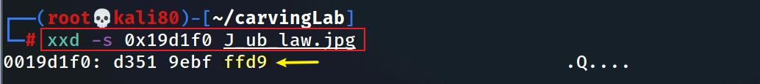
Alternative: Show JPG header and tail signatures
Alternative: Hexdump the first 120 bytes
Alternative: Show hex from a start address

Slide 21
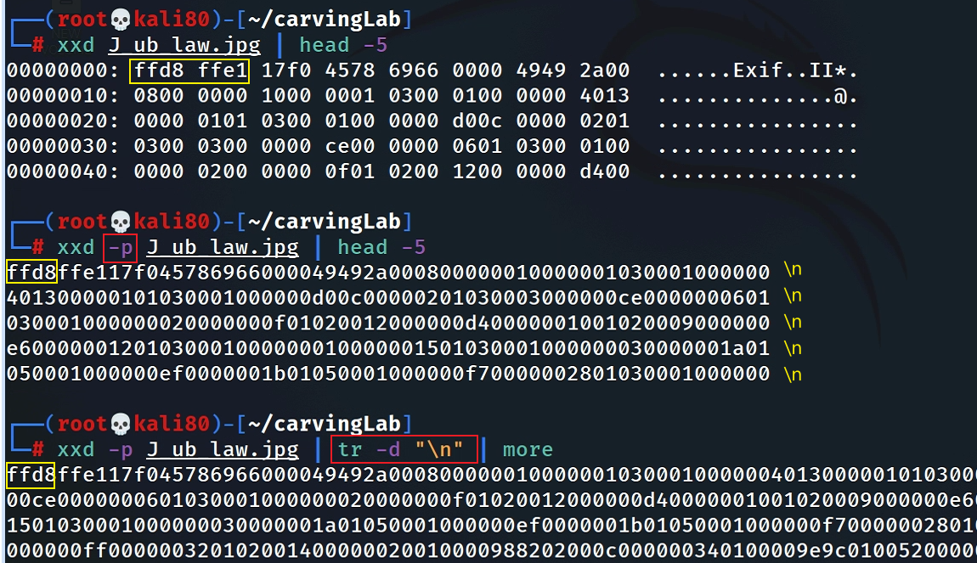
Search signatures in plain hexdump
Convert hexdump to plain hexdump
space causes search problem if we want to search for “ffd8ffe1” (show it in next slide)

Slide 22
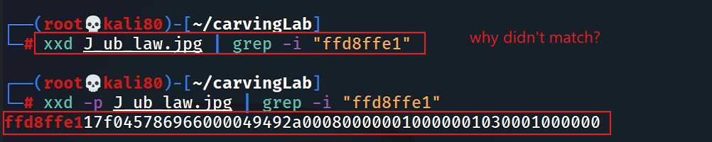
Search header in plain hexdump
Search tail in plain hexdump
How to search hex numbers between 2 lines? e.g., 0105?

Slide 23
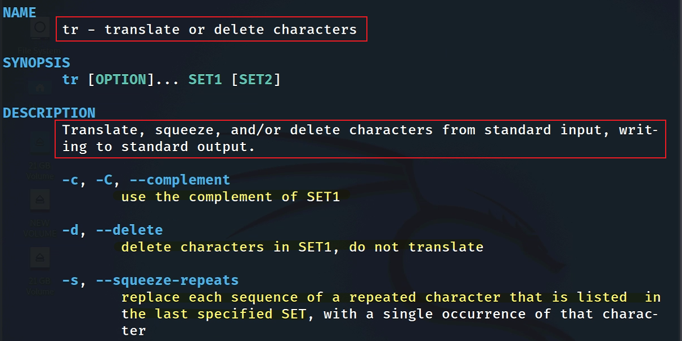
remove newline “\n”
tr command introduction

Slide 24
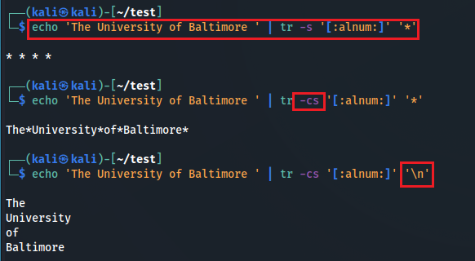
squeeze alphabets and numbers and replace them with *
squeeze NON (alphabets and numbers) and replace them with *
squeeze NON (alphabets and numbers) and replace them with \n
Notes:
echo 'The University of Baltimore ' | tr -s '[:alnum:]' '*’
echo 'The University of Baltimore ' | tr -cs '[:alnum:]' '*’
echo 'The University of Baltimore ' | tr -cs '[:alnum:]' '\n'

Slide 25
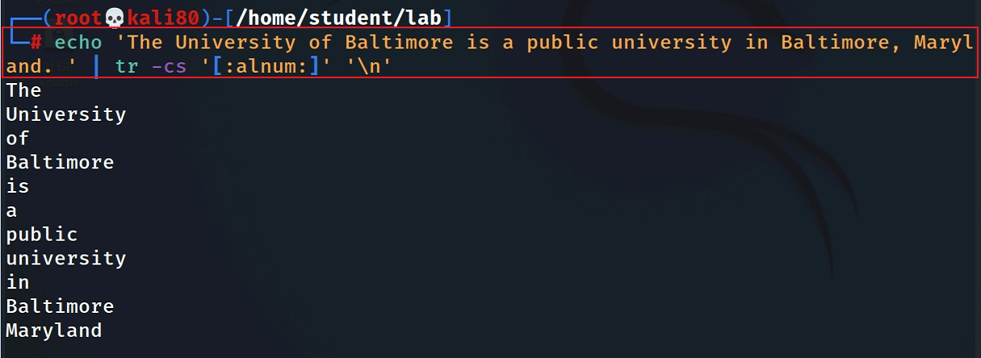
A small tr example: match all non-alphanumerical characters and replace them with a new line
Two tasks:
Squeeze repeated characters listed in a set ‘’
replace squeezed with “\n”
Notes:
echo 'The University of Baltimore is a public university in Baltimore, Maryland. ' | tr -cs '[:alnum:]' '\n'

Slide 26
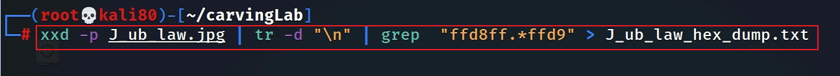
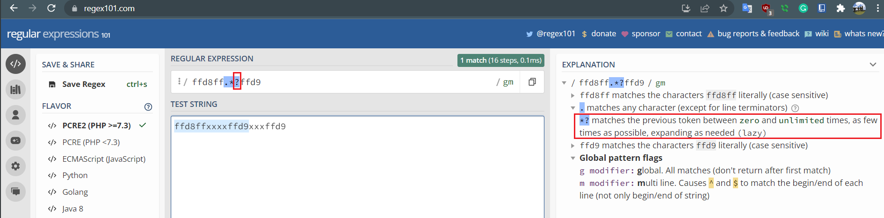
Dump the content between header and tailer signature
Match plain hexdump between header and tail signature and save the plain hexdump to a textfile
-o
Notes:
xxd -p J_ub_law.jpg | tr -d "\n" | grep - o "ffd8ff.*ffd9" > J_ub_law_hexdump.txt

Slide 27
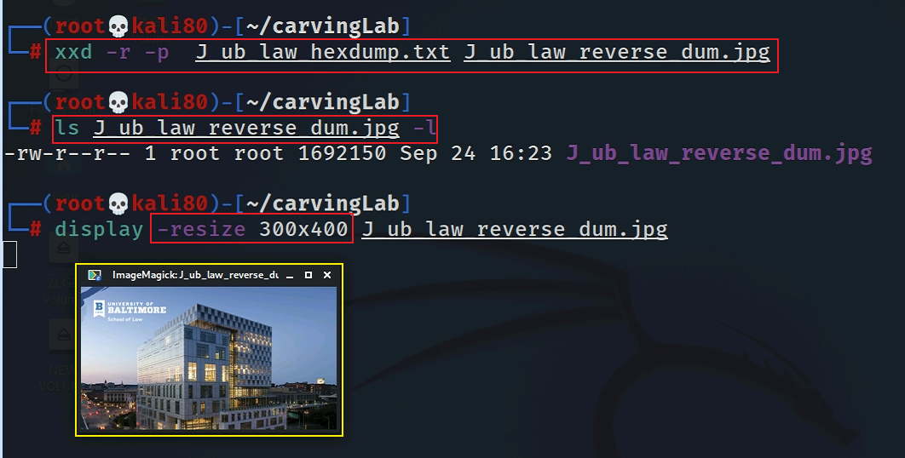
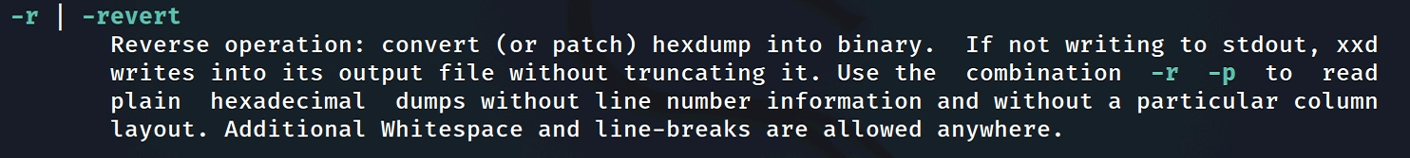
Convert a plain hexdump to back into binary
Notes:
xxd -r -p J_ub_law_hexdump.txt J_ub_law_reverse_dum.jpg

Slide 28

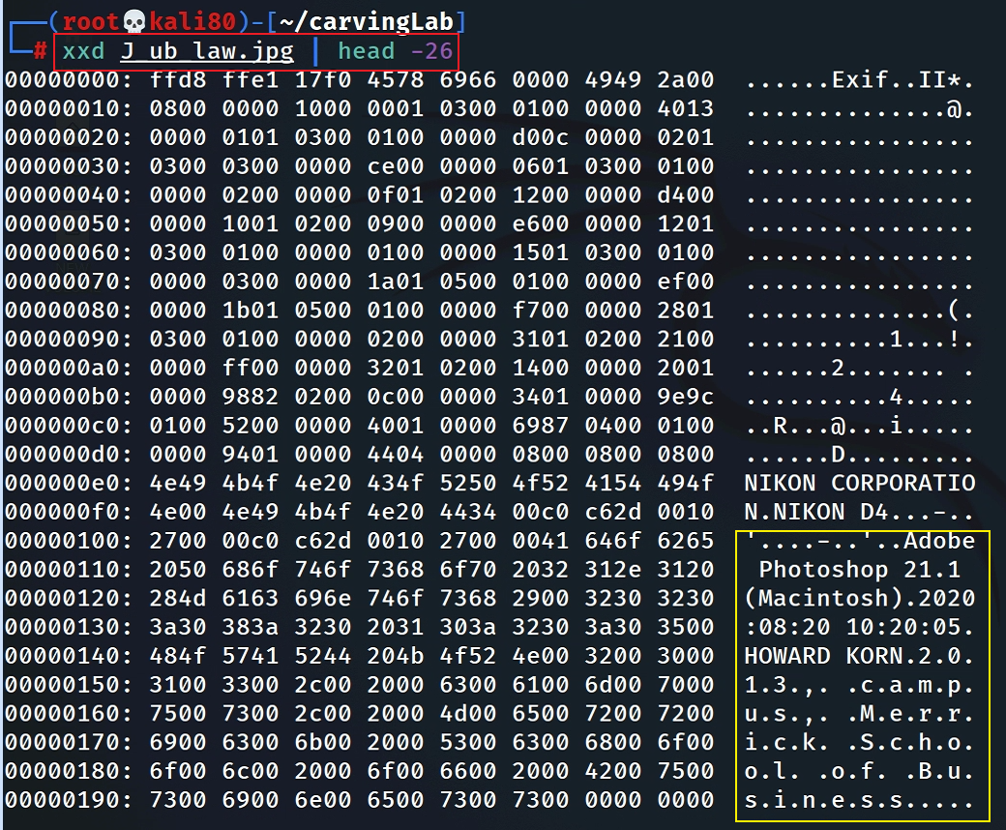
Interesting evidence in file header

Slide 29
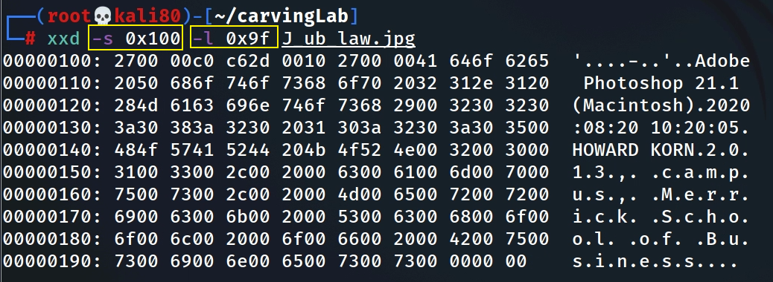
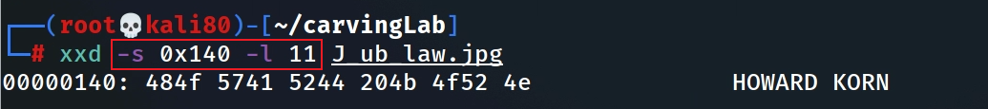
Hexdump Photoshop infor starts from 0x100 and list 0x9f bytes
Hexdump the name
Notes:
xxd -s 0x100 -l 0x9f J_ub_law.jpg

Slide 30
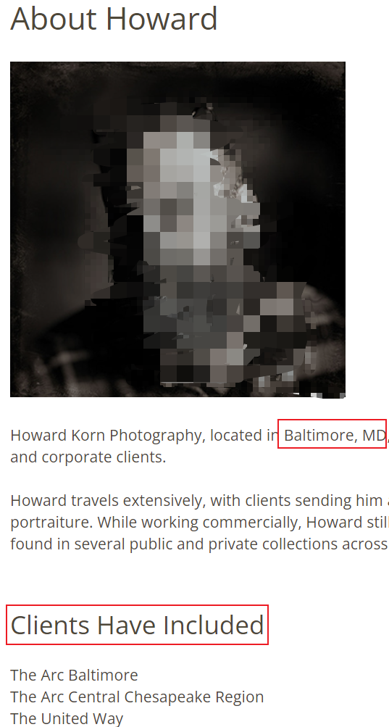
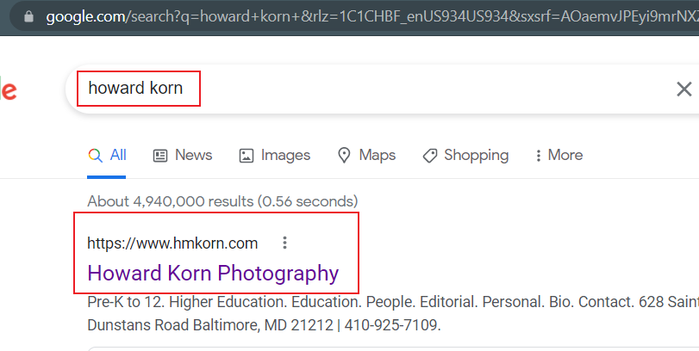
Who is Howard Korn?

Slide 31
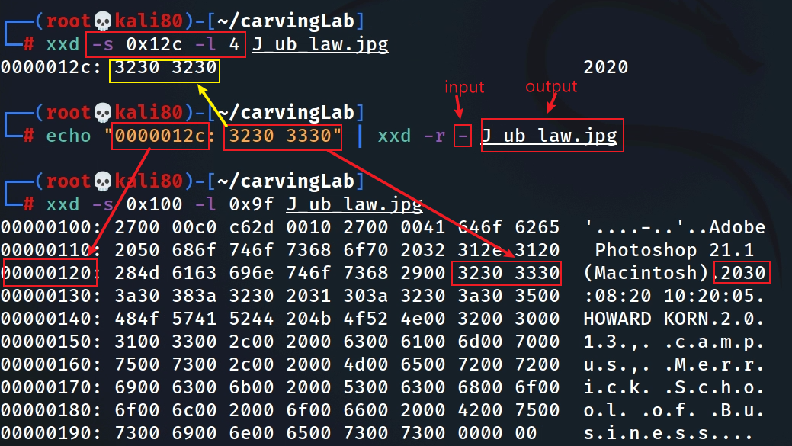
Fake the date (2020 -2030)
Hexdump the year
xxd reverses hexdump to binary (read from standard input. Overwrite 2020 with 2030)
If infile is specified as a `-' character, then input is taken from standard input.

Slide 32
Security implications
Modify software function
unlimited resource for games
Bypass security check
authentication
Insert malicious code
backdoor

Slide 33
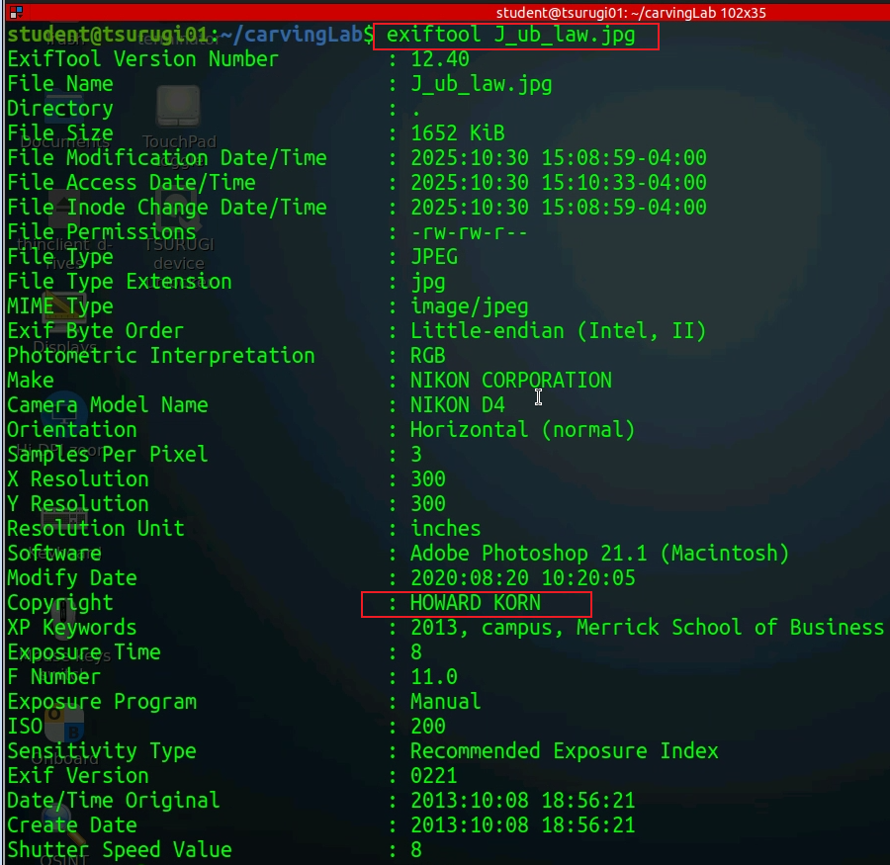

Slide 34
What is data carving?

Slide 35







Anything can be wrong!
Corrupted MFT entry
unallocated clusters
corrupted file header
File1 | File2 | Deleted file

Slide 36
Data carving
Reassembling computer files from fragments in the absence of filesystem metadata
A well-known computer forensics term
aka file carving
Identify and extract (carve) the file
based on analysis of file formats (if a file head is corrupted)
based on file signature information
without the assistance of the file system that originality created the file

Slide 37
Example scenarios
Scenario 1: A file (A) is hidden inside of another file (B). You can’t open the file B because the B’s header is corrupted.
Scenario 2: A suspect deleted files. The files contains an important information. A file occupies a few clusters. Unfortunately, some clusters are reused (overwritten) by new files.
A forensic expert really wants to recover files, even a partial files.

Slide 38
Extracting images from a corrupted Word document
using bless

Slide 39
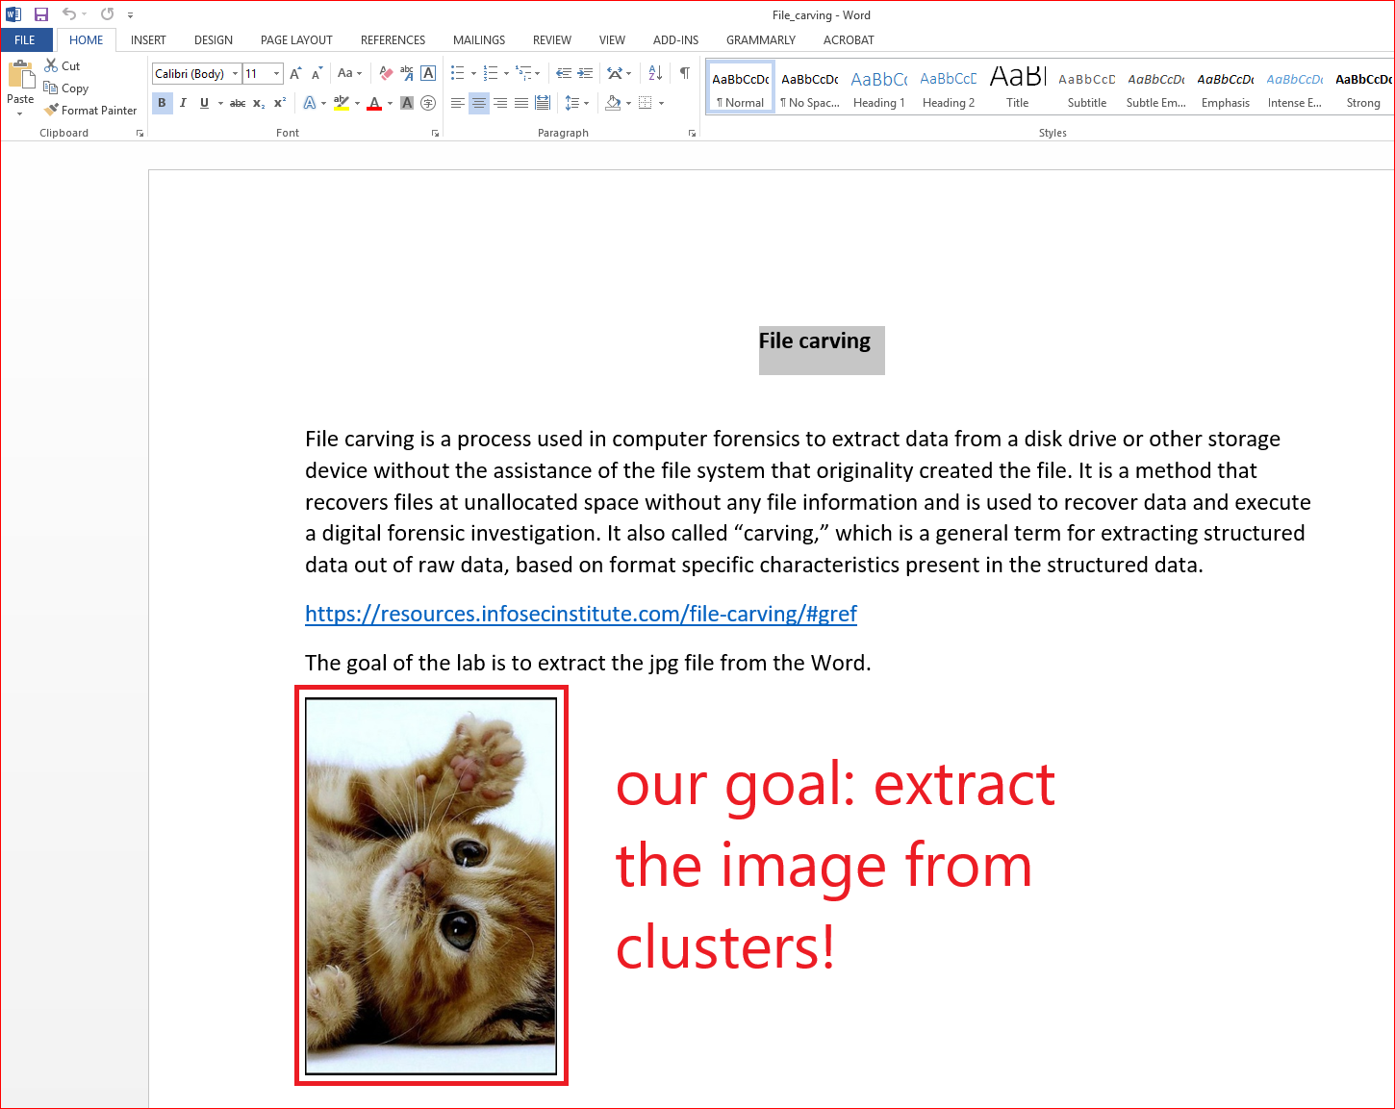
We can’t open the file because the file is corrupted (accidentally or intentionally)!
How to corrupted a file?

Slide 40
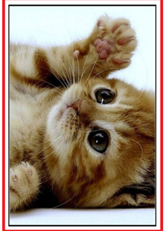
Key idea
What is the offset address of the signature =>
FFD8FFE9
FFD9
⬅What is the offset address of the signature

Slide 41
Prepare required files for the lab
the file we need
Notes:
wget -q https://raw.githubusercontent.com/frankwxu/digital-forensics-lab/main/Basic_Computer_Skills_for_Forensics/file_carving/File_Carving_Manually/File_carving.docx

Slide 42
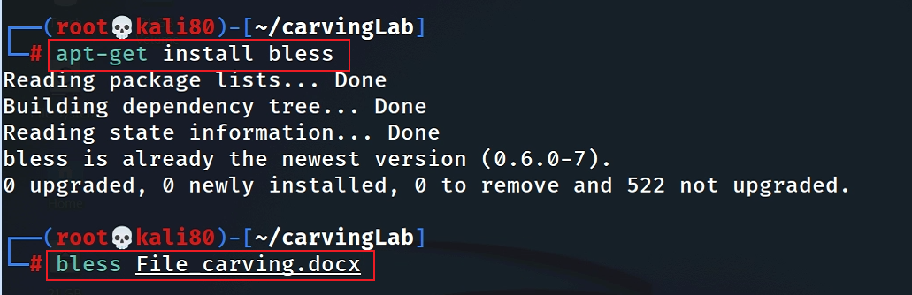
View the file in a hex editor
Notes:
ask for install

Slide 43
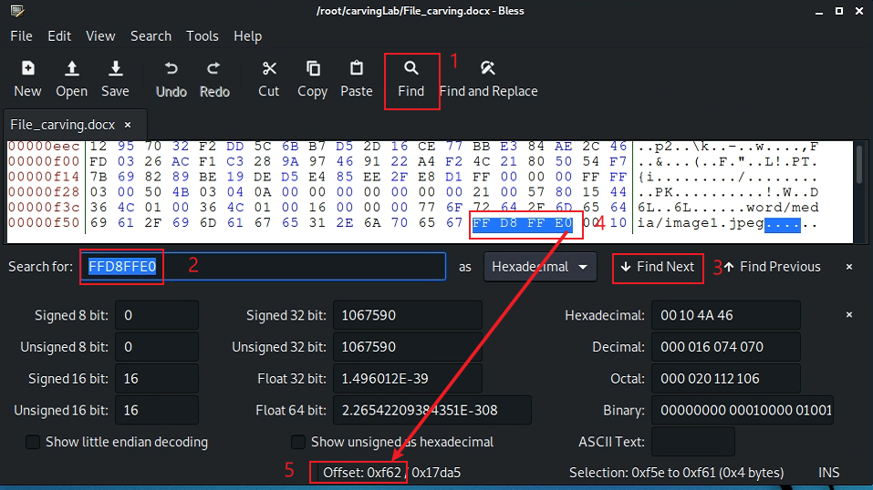
Search file header start offset – 0F5E
beginning of the highlighted position

Slide 44
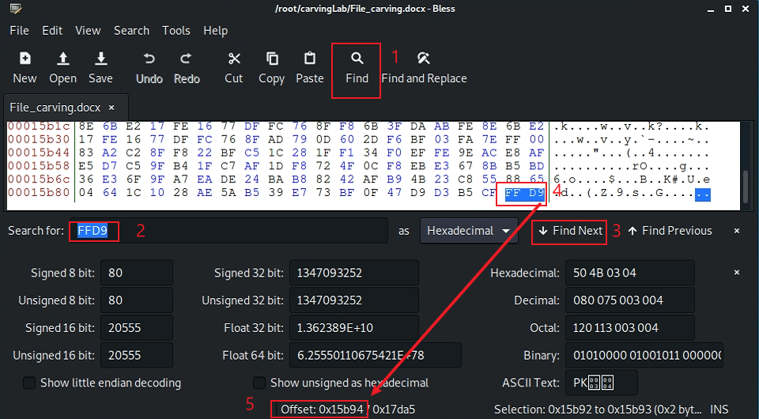
Search file trailer ends offset – 15B93
after the highlighted position

Slide 45
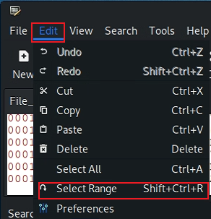
Select hex from header to tail
(0F5E)16=(3934)10
(15B93)16=(88979)10
Notes:
echo $((16#f5e))
echo $((16#15b93))

Slide 46
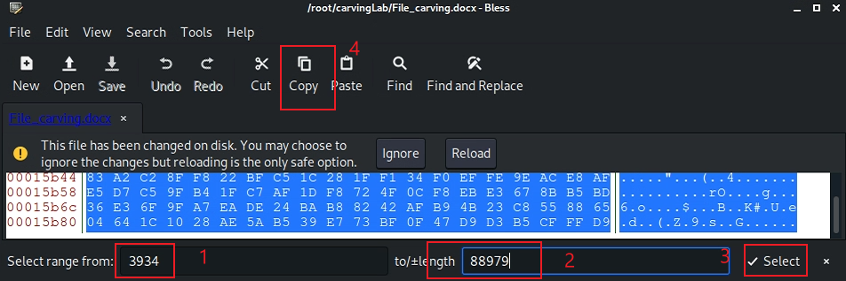

Copy the selection
0x0F5E
0x15B93

Slide 47
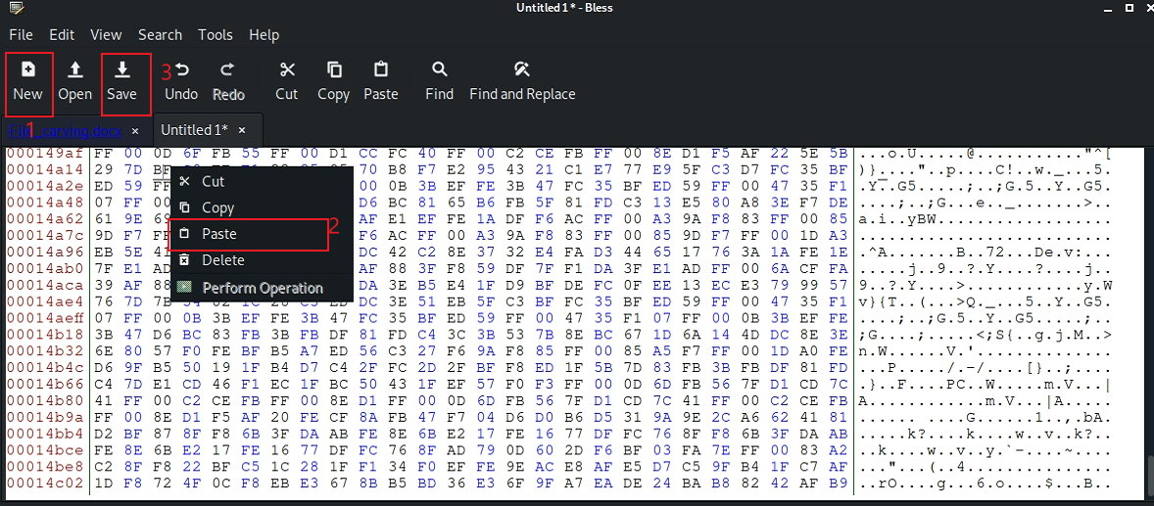
Paste the selection

Slide 48
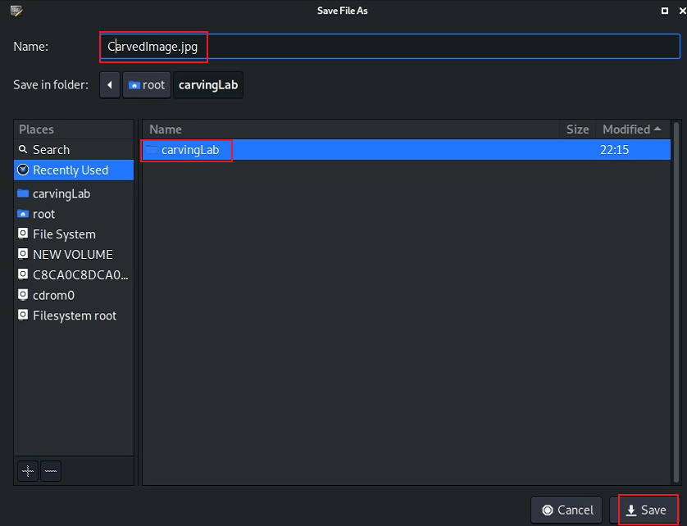
Save the image

Slide 49
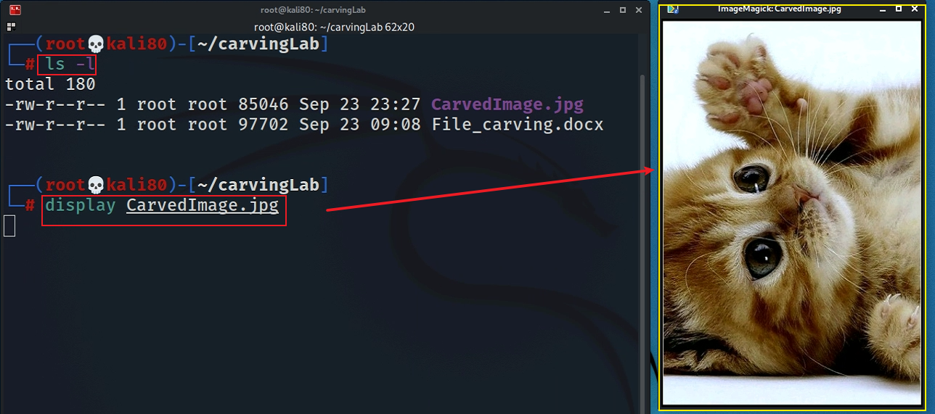
Show the carved image

Slide 50

Alternative 1: using xxd
Must have –p, which tells xxd the input is a plain text
do you need a lazy match <.*?>
Notes:
xxd -p File_carving.docx | tr -d '\n' | grep -o "ffd8ffe0.*ffd9" | xxd -r -p - CarvedCat.jpg

Slide 51


Slide 52

Alternative 2: using binwalk

Slide 53

Why not start from 3882? Word doc includes an embedded header (52 bytes), i.e., 3934=3882+52
88980-85046=3934

Slide 54

Alternative 3: using binwalk -e

Slide 55
Carving/Recovering a USB image
using scalpel

Slide 56


Prepare a USB image for file carving
Download the zipped USB image
Compute hashes
Notes:
wget -q https://raw.githubusercontent.com/frankwxu/digital-forensics-lab/main/Basic_Computer_Skills_for_Forensics/file_carving/usb_image/120M.7z

Slide 57

List the content of the zipped file

Slide 58

List the content of the zipped file
e : Extract files from archive (without using directory names)

Slide 59

Verify the hashes

Slide 60

Exam the content of the USB
Display partitions

Slide 61

Find deleted files

Slide 62

Decide which file types need to carve
Save it and quit!

Slide 63

Show help

Slide 64

Carving the USB image

Slide 65

Show carved files

Slide 66

Show audit log

Slide 67


Display two carved jpg image

Slide 68
Summary
File header and tail signatures are used to identify file types
The content of a file is enclosed in header and tail signatures
Many tools can used for carving file content
Note the file names/metadata can’t be retrieved

